Slide 1

BC2410, Prescriptive Analytics From Data to Decision
Lecture 8

Slide 2
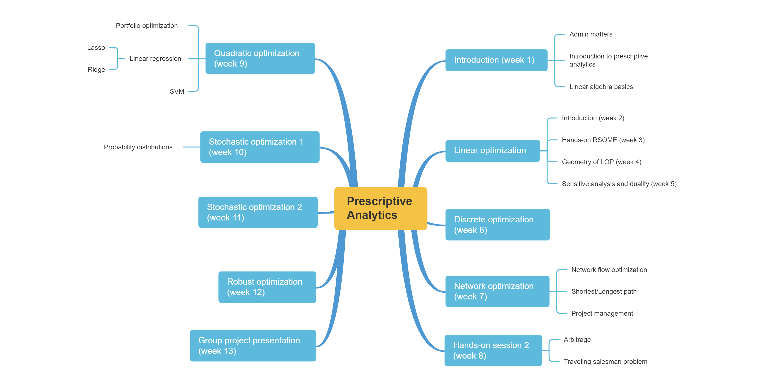
Schedule

Slide 3
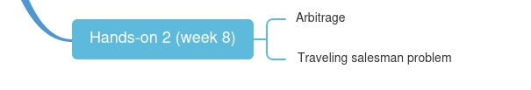
Schedule

Slide 4
Arbitrage Detection
$ 1 = € r_{1,} € 1 = $ r₂
What happen if r₁ r₂ > 1?
No suppose you can exchange among n currencies, how can you detect whether there exists arbitrage opportunities?
 | USD | EUR | GBP | AUD | JPY
USD | 1 | 0.639 | 0.537 | 1.0835 | 98.89
EUR | 1.564 | 1 | 0.843 | 1.6958 | 154.773
GBP | 1.856 | 1.186 | 1 | 2.014 | 184.122
AUD | 0.9223 | 0.589 | 0.496 | 1 | 91.263
JPY | 0.01011 | 0.00645 | 0.00543 | 0.01095 | 1

Slide 5
Traveling Salesman Problem--Applications
Package delivery
School bus
Drilling holes for circuit boards
Drone flight planning
…
Notes:
https://www.math.uwaterloo.ca/tsp/

Slide 6
Traveling Salesman Problem
Start from one node
Visit each node only once
Come back to the starting node
Identify the path with the least cost (distance)
Notes:
https://www.math.uwaterloo.ca/tsp/

Slide 7
Number of Routes
3
…
2
2
3
2
…
1
2
1
3
1
4
1
N
?
?
?
?
Notes:
https://www.math.uwaterloo.ca/tsp/

Slide 8







Is This a Shortest Path Problem?
Network flow formation
3
4
1
6
2
5

Slide 9
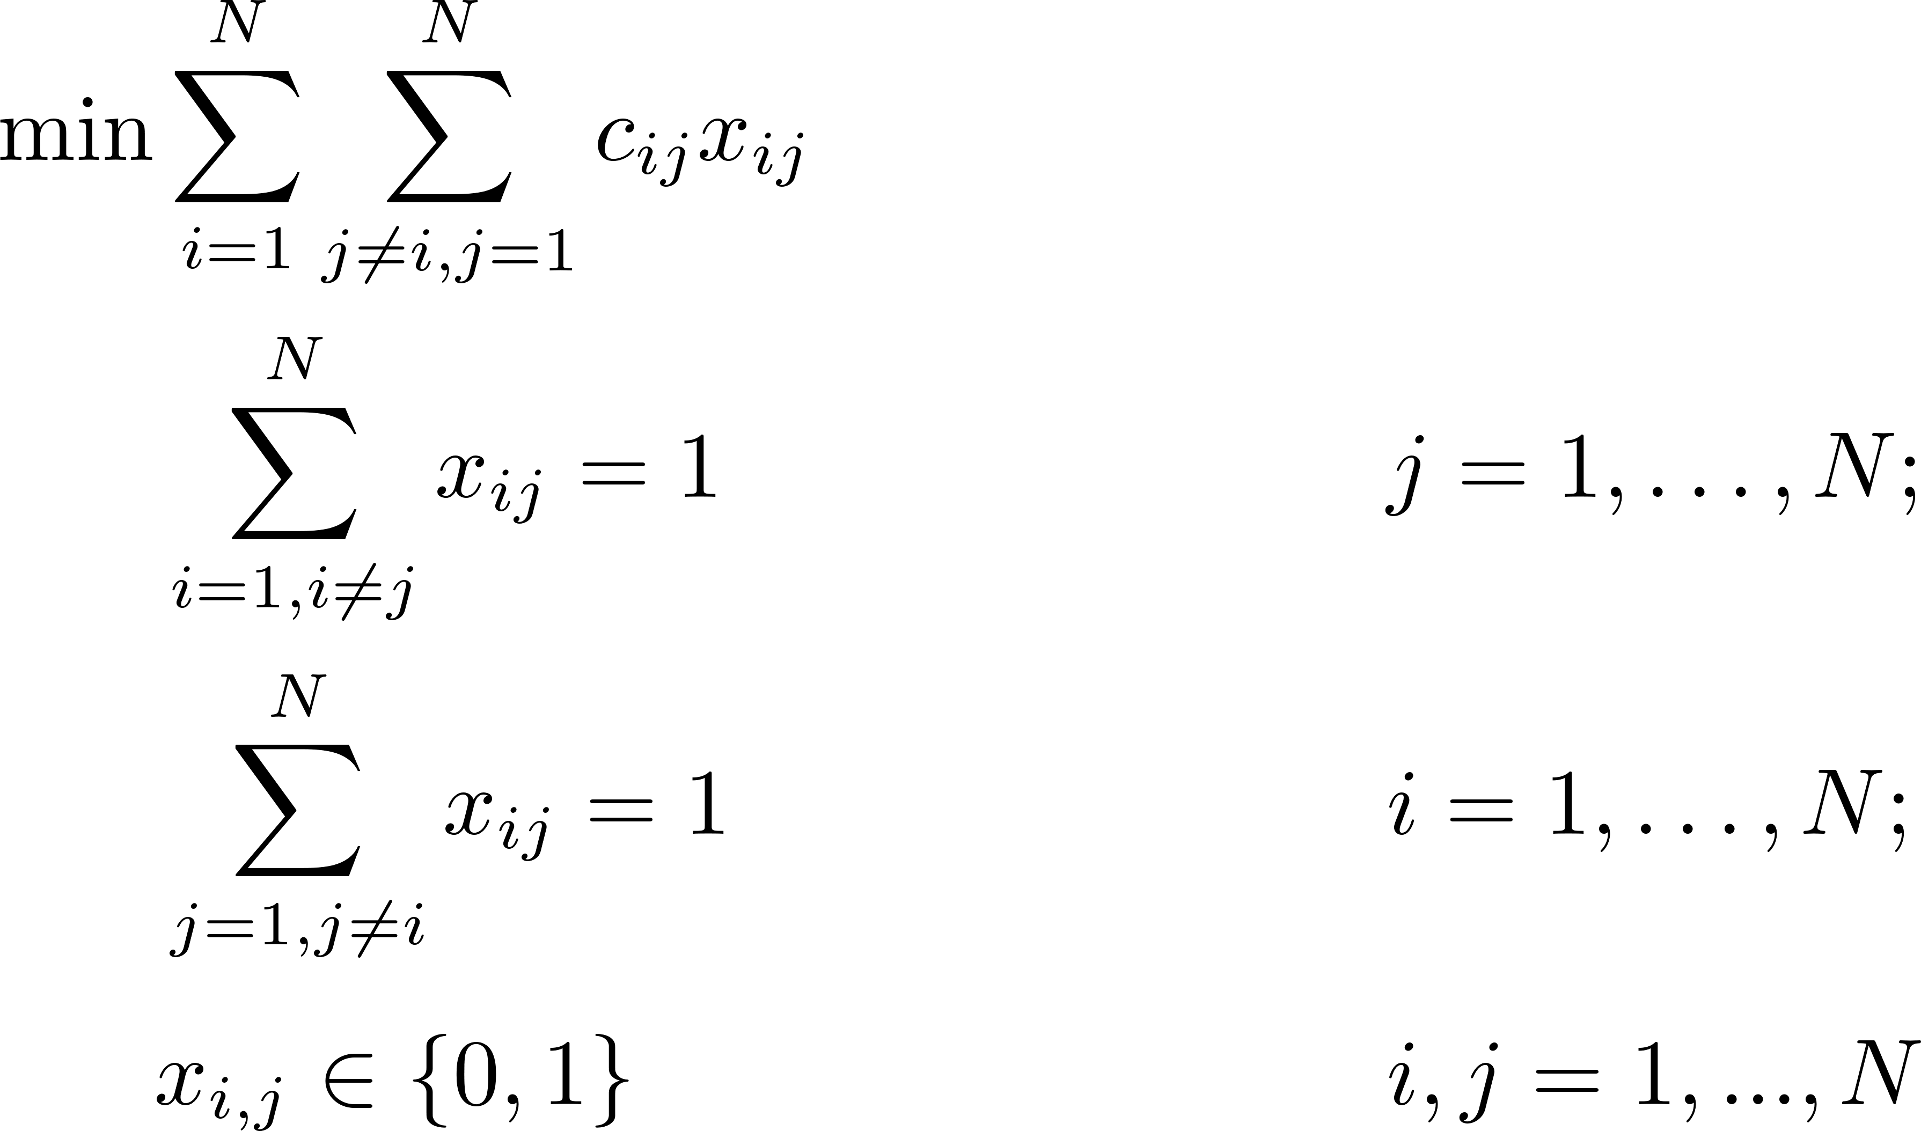
Traveling Salesman Problem
An integer programming approach
Any problem with this model?

Slide 10
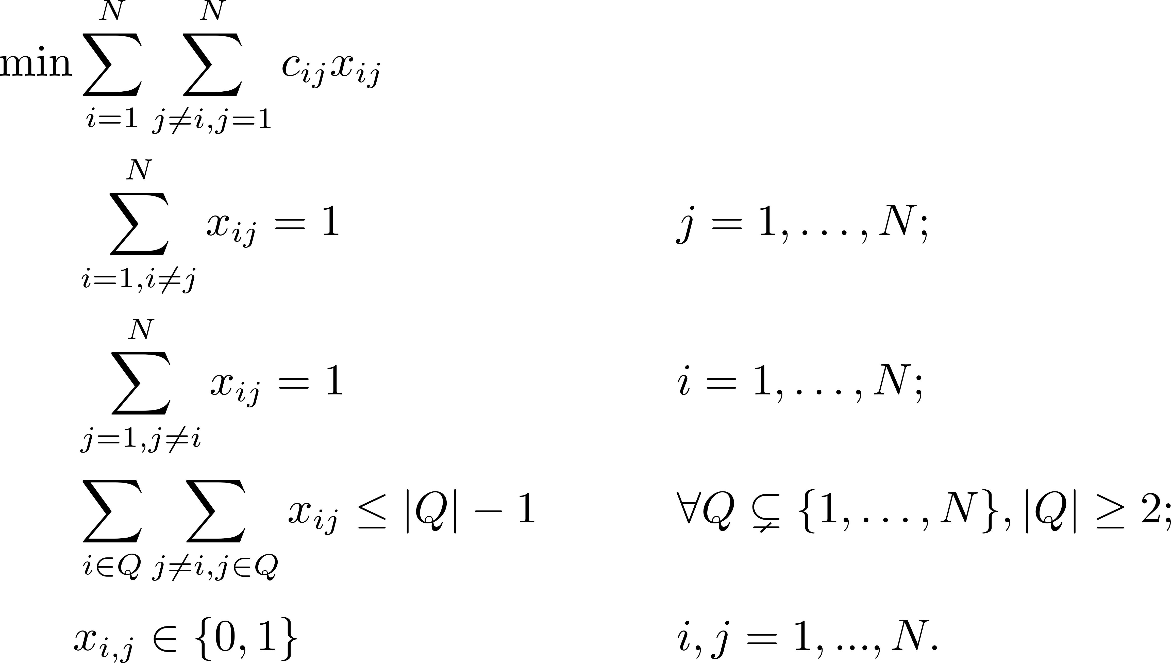
Traveling Salesman Problem
An integer programming approach
How about this model?

Slide 11
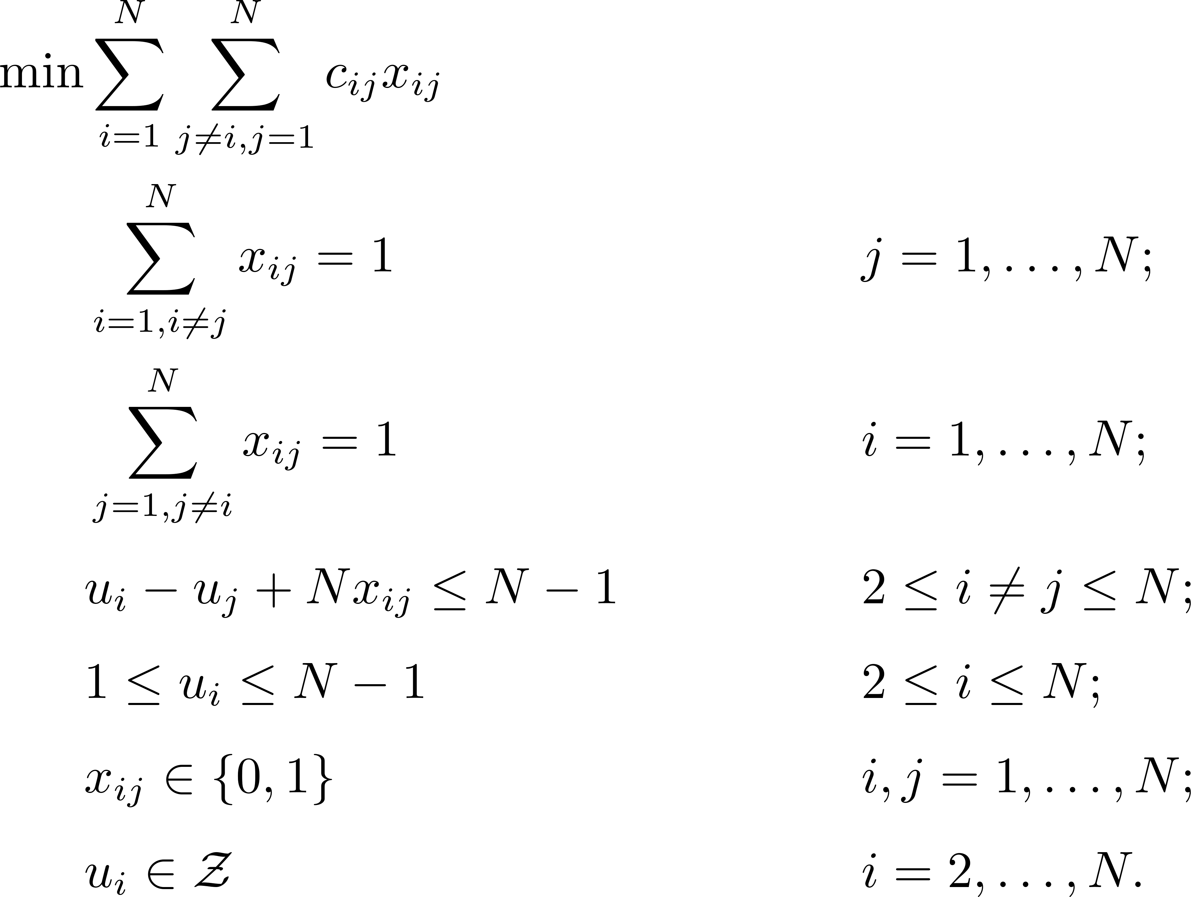
Traveling Salesman Problem
An integer programming approach
How about this model?
Miller–Tucker–Zemlin Formulation
Number of constraints vs. N?

Slide 12
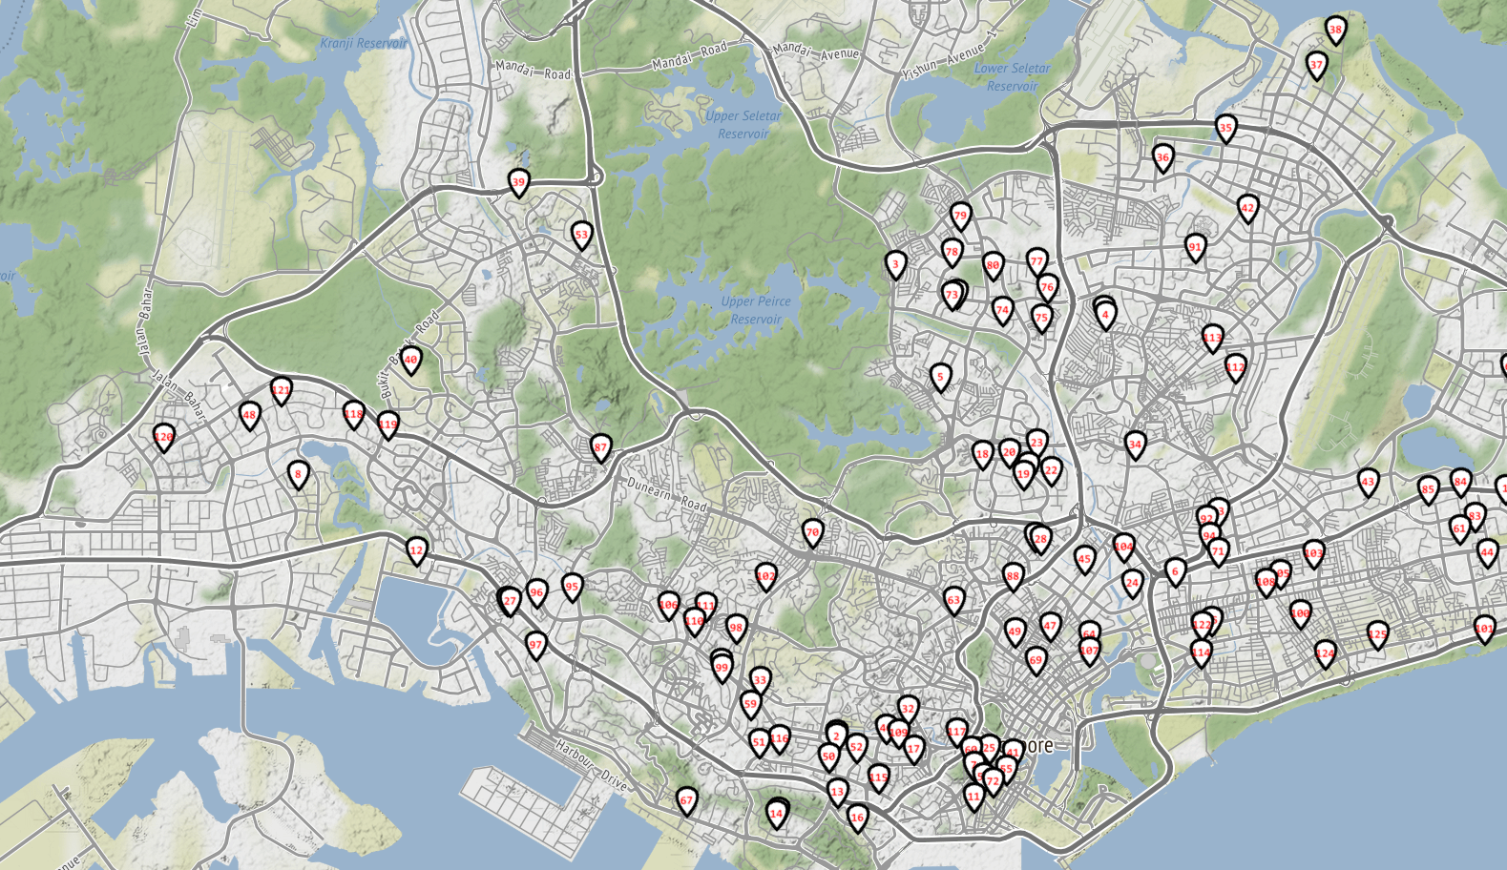
Milk Delivery for Hawker Centers
Jack is a driver of ABC Milk Company.
He is assigned to deliver fresh milk for 20 hawker centers.
Visit each center only once with least amount of time (distance)

Slide 13
Geolocation Data

Slide 14
Some Questions
How to obtain the distance between any two centers?
Which model to use?
How to obtain the real-time routes?
What if Jack can only deliver milk to some of the centers each time (you need to schedule three routes) ?

Slide 15
Vehicle Routing Problem (VRP)
Each vehicle starts from same origin
Each node will be visited once by one vehicle
Each vehicle must return to the origin
Identify the paths with the least cost (distance) for each vehicle

Slide 16
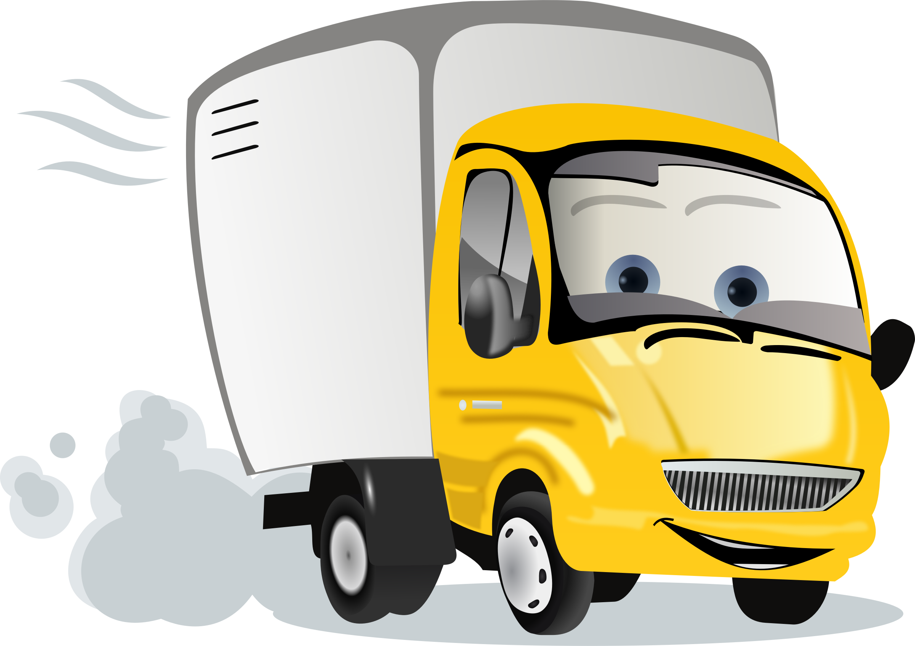
Vehicle Routing Problem (VRP)
4
5
2
3
6
1
3
S
3

Slide 17
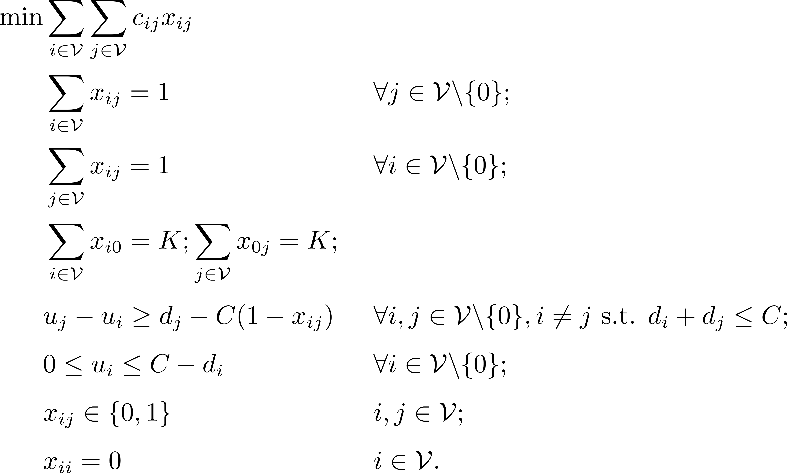

Vehicle Routing Problem (Optional)
An integer programming approach
$𝒱=\left\{0, 1, 2, …, N\right\}$
u_{i}: The load left in the vehicle after visiting customer i
D_{i}: the demand of customer i.
C: capacity of each vehicle
Many other better formulations
The problem can be efficiently solved by many heuristics

